Slide 1
OPERATIONAL RESEARCH

Slide 2
Optimization

Slide 3
Overview
The value you are trying to Optimize
Try to make a square as big as possible, What will be objective Function ?
Area = a x b
a
a
Goals of Optimization
To Improve the value of the Objective Function
b
b
Decision Variables / Design Variables
Values the Optimizer can Change
Length of Square
Minimize
Maximize

Slide 4
LPP Using Simplex Method

Slide 5
Overview
Slack Variable
Variable added to a <= Constraint to convert it to an Equation (=)
Slack Variable indicates unused resources
A Slack Variable contributes nothing to objective function values
Surplus/Artificial Variables
Variable subtracted from a >= constraint to convert it to an Equation (=)
Surplus Variable represents an excess above a constraint requirement level
Surplus variables contribute nothing to the calculated value of the objective function

Slide 6
Example
Objective Function
Maximize Z = 12 x1 + 16 x2
Subject to Constraints
10 x1 + 20 x2 <= 120
8 x1 + 8 x2 <= 80
x1, x2 >= 0
Constraints

Slide 7
Step – Convert all inequality constraints into equality (use slack variables)
Let’s add Slack Variables to Constraints (How many Slack Variables)
10 x1 + 20 x2 + s1 = 120
8 x1 + 8 x2 + s2 = 80
We need to Add these Slack variables to the Objective Function too
Maximize Z = 12 x1 + 16 x2 + 0 s1 + 0 s2

Slide 8
Step – Develop Initial Simplex Table
Co-efficient of Basic Variables
Co-efficient of Objective Function
10 x1 + 20 x2 + s1 = 120
Maximize Z = 12 x1 + 16 x2 + 0 s1 + 0 s2
8 x1 + 8 x2 + s2 = 80
C Bi | Cj |  |  |  |  | Solution | Ratio
 | Basic Variables
12 16 0 0
x1 x2 s1 s2
0
s1
10 20 1 0 120
0
s2
8 8 0 1 80
Zj
0 0 0 0 0
Cj - Zj
12 16 0 0
Zj = a1x1 + a2x2 + a3x3 + ..anxn
.. 0x10 + 0x20 …

Slide 9
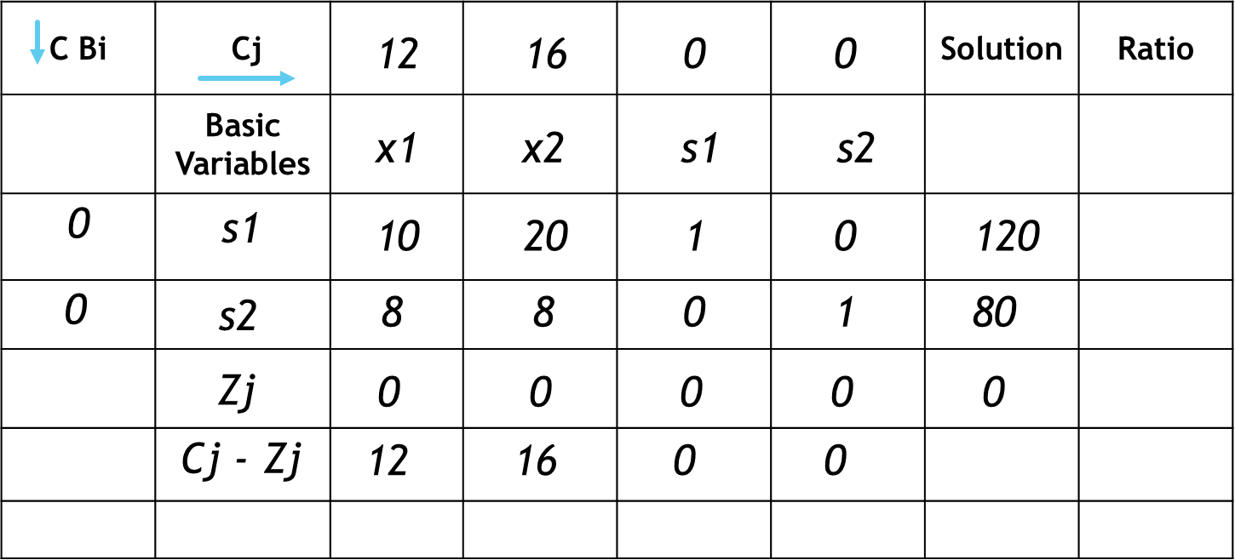
Is it a Optimal Solution ?
For Maximization
All Cj – Zj <= 0
For Minimization
All Cj – Zj >= 0

Slide 10
Step – Reach Optimality
Select the Maximum Value of Cj – Zj
The column of Maximum Cj – Zj value becomes the Key Column
Find the Ratio = Solution / Key Column
The Row with Minimum Value of Ratio is called Key Row
The intersection Point is called Key Element

Slide 11
Step – Example
Key Column
Key Row
120 / 20
C Bi | Cj |  |  |  |  | Solution | Ratio
 | Basic Variables
12 16 0 0
Entering Variable
x1 x2 s1 s2
0
s1
10 20 1 0 120
6
0
s2
8 8 0 1 80
10
Least Positive
Zj
0 0 0 0 0
Cj - Zj
12 16 0 0
Key Element
Leaving Variable
Most Positive

Slide 12
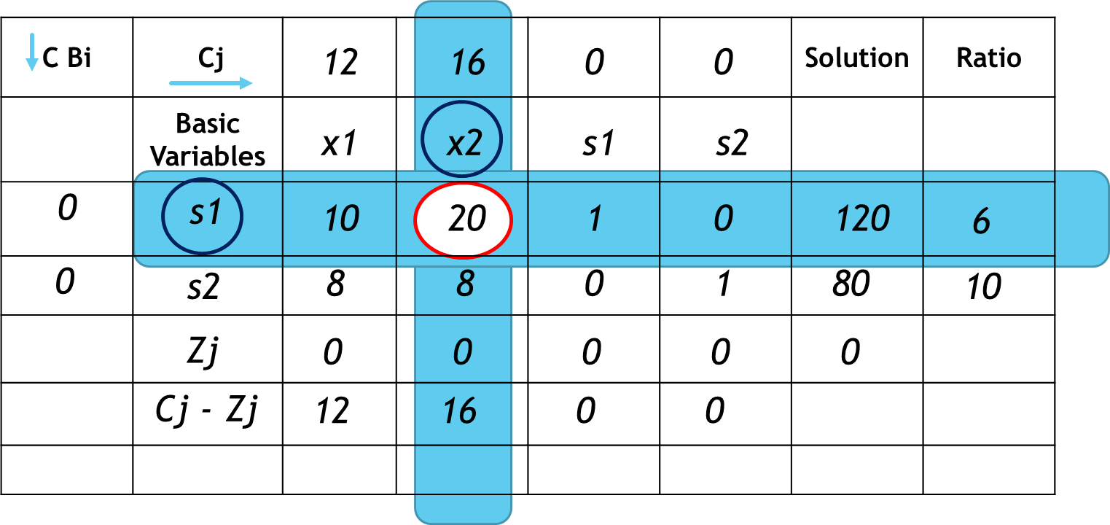
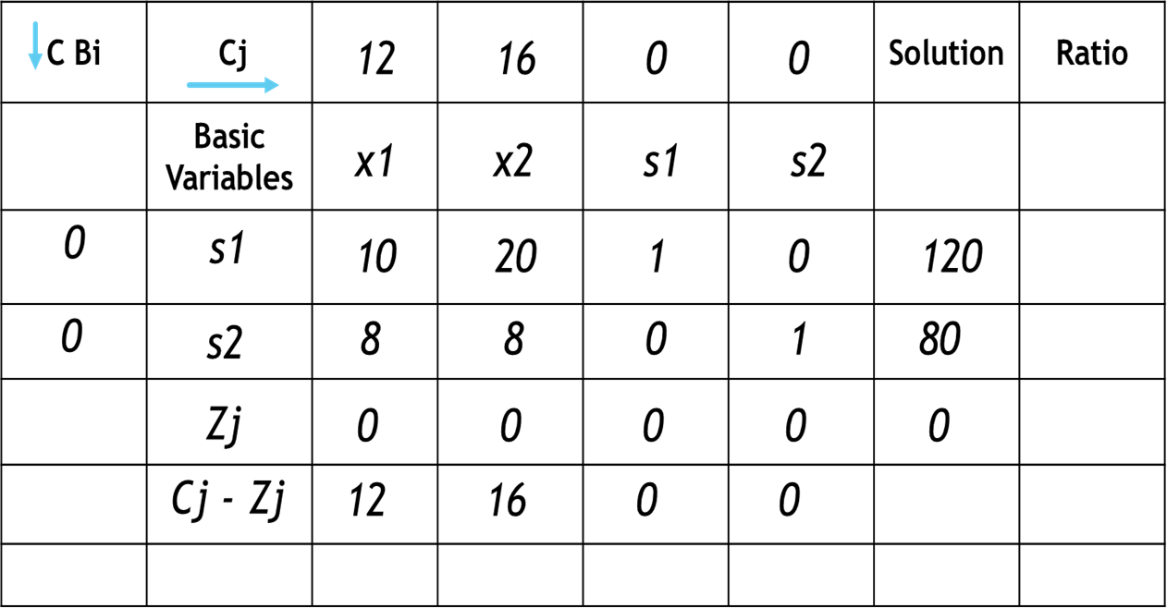
First Iteration Table
New s2 = 8 -
New s2 = 0 -
New s2 = 80-
New s2 = 1 -
New s2 = 8 -
8 x 10
80
8
960
8 x 1
8 x 120
0
8 x 20
8 x 0
160
: 8 -
: 8 – 4 = 4
: 0 -
: 80 -
: 8 -
: 1 -
: 0 – 2/5 = -2/5
: 80 – 48 = 32
: 8 – 8 = 0
: 1 – 0 = 1
20
20
20
20
20
20
20
20
20
20
C Bi | Cj |  |  |  |  | Solution | Ratio
 | Basic Variables
12 16 0 0
x1 x2 s1 s2
16
x2
1/2 1 1/20 0 6
0
s2
4 0 -2/5 1 32
Zj
8 16 4/5 0
Cj - Zj
4 0 -4/5 0
New x2 = old values / Key Element
New s2 = Old Value –
Corresponding Key Column Value X Corresponding Key Row Value
Key Element Value

Slide 13
Iteration 1 – Find Ratio
Key Column
Key Row
C Bi | Cj |  |  |  |  | Solution | Ratio
 | Basic Variables
12 16 0 0
Entering Variable
x1 x2 s1 s2
16
x2
1/2 1 1/20 0 6
12
0
s2
4 0 -2/5 1 32
8
Zj
8 16 4/5 0
Cj - Zj
4 0 -4/5 0
Key Element
Leaving Variable

Slide 14
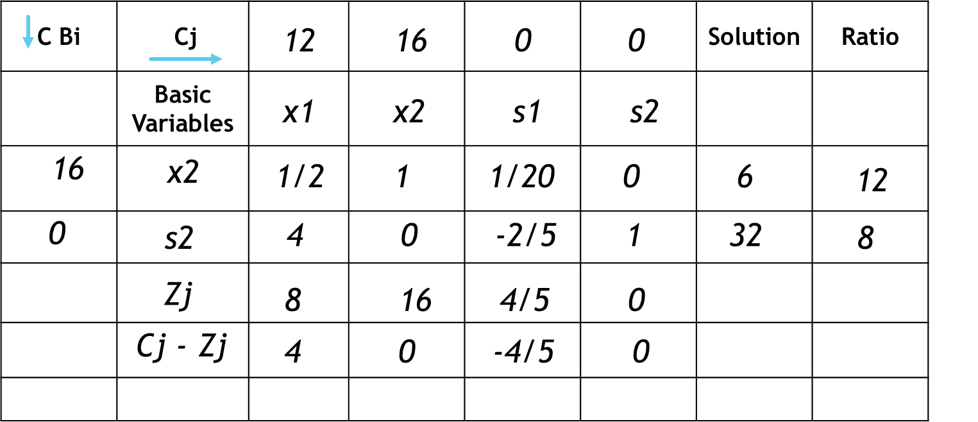
Iteration 2
C Bi | Cj |  |  |  |  | Solution | Ratio
 | Basic Variables
12 16 0 0
x1 x2 s1 s2
16
x2
0 1 1/10 -1/8 2
12
x1
1 0 -1/10 1/4 8
Zj
12 16 2/5 1 128
Cj - Zj
0 0 -2/5 -1
New x1 = old values / Key Element
Corresponding Key Column Value X Corresponding Key Row Value
New x2 =Old Value -
Key Element Value

Slide 15
Final Optimality
C Bi | Cj |  |  |  |  | Solution | Ratio
 | Basic Variables
12 16 0 0
x1 x2 s1 s2
16
x2
0 1 1/10 -1/8 2
12
x1
1 0 -1/10 1/4 8
Zj
12 16 2/5 1 128
Cj - Zj
0 0 -2/5 -1
x1 = 8
x2 = 2
Z = 128

Slide 16
Big M Simplex Method

Slide 17
Simplex Method
Big M Simplex Method
Maximize Z = 12 x1 + 16 x2
Subject to Constraints
10 x1 + 20 x2 <= 120
8 x1 + 8 x2 <= 80
x1, x2 >= 0
Minimize Z = 12 x1 + 16 x2
Subject to Constraints
10 x1 + 20 x2 >= 120
8 x1 + 8 x2 >= 80
x1, x2 >= 0
Constraints <= 0
Constraints >= 0
Add Surplus Variables
Subtract Surplus Variables
Add Artificial Variables

Slide 18
Example
Minimize Z = 7 x1 + 15 x2 + 20 x3
Subject to Constraints
2 x1 + 4 x2 + 6 x3 >= 24
3 x1 + 9 x2 + 6 x3 >= 30
x1, x2, x3 >= 0

Slide 19
Step – Convert all inequality constraints into equality (use slack & Artificial variables)
Let’s Subtract Slack Variables & Add Artificial Variables
2 x1 + 4 x2 + 6 x3 - s1 + a1 = 24
3 x1 + 9 x2 + 6 x3 - s2 + a2 = 30
We need to Add these Slack & Artificial variables to the Objective Function
Value for Slack variables should be Zero
Value for Artificial Variables should Maximum (i.e. M)
Minimize Z = 7 x1 + 15 x2 + 20 x3 + 0 s1 + 0 s2 + Ma1 + Ma2

Slide 20
Step – Develop Initial Simplex Table
Co-efficient of Basic Variables
Co-efficient of Objective Function
Z = 7 x1 + 15 x2 + + 20 x3 + 0 s1 + 0 s2 + Ma1 + Ma2
C Bi | Cj |  |  |  |  |  |  |  |  | Solution | Ratio
 | Basic Varibls
7 15 20 0 0 M M
x1 x2 x3 s1 s2 a1 a2
M
a1
2 4 6 -1 0 1 0 24
M
a2
3 9 6 0 -1 0 1 30
Zj
5M 13M 12M -M -M M M 54M
Cj - Zj
7-5M 15-13M 20-12M M M 0 0
Zj = a1x1 + a2x2 + a3x3 + ..anxn
2 x1 + 4 x2 + 6 x3 - s1 + a1 = 24
Optimality Min Z : Cj – Zj >= 0
3 x1 + 9 x2 + 6 x3 - s2 + a2 = 30

Slide 21
Continue
Key Column
Ratio = 24 / 4
Entering Variable
C Bi | Cj |  |  |  |  |  |  |  |  | Solution | Ratio
 | Basic Varibls
7 15 20 0 0 M M
x1 x2 x3 s1 s2 a1 a2
Key Row
M
a1
2 4 6 -1 0 1 0 24
6
M
a2
3 9 6 0 -1 0 1 30
10 /3
Zj
5M 13M 12M -M -M M M 54M
Least Positive
Cj - Zj
7-5M 15-13M20-12M M M 0 0
Key Element
Leaving Variable
Most Negative

Slide 22
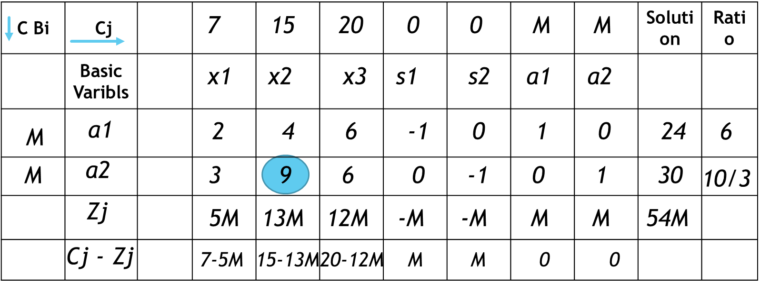
First Iteration Table
Optimality Condition For Minimization
All Cj – Zj >= 0
 | C Bi | Cj |  |  |  |  |  |  |  | Solution | Ratio
 |  | Basic Varibls
Row3
Row4
7 15 20 0 0 M M
x1 x2 x3 s1 s2 a1 a2
M
a1
2/3 0 10/3 -1 4/9 1 ** 32/3
15
x2
1/3 1 2/3 0 -1/9 0 ** 10/3
Zj
2/3M+5 15 10/3M+10 -M 4/9M-5/3 M ** 32/3M+50
Cj - Zj
-2/3M+2 0 -10/3M+10 M -4/9M+5/3 0 **
New x2 = old values / Key Element
Row4 Value
New a1 = Old Value –
Corresponding Key Col Val X Corresponding Key Row Value
Key Element Value

Slide 23
Iteration Table
 | C Bi | Cj |  |  |  |  |  |  |  | Solution | Ratio
 |  | Basic Varibls
Row3
Row4
7 15 20 0 0 M M
x1 x2 x3 s1 s2 a1 a2
M
a1
2/3 0 10/3 -1 4/9 1 ** 32/3
16/5
15
x2
1/3 1 2/3 0 -1/9 0 ** 10/3
5
Least Positive
Zj
2/3M+5 15 10/3M+10 -M 4/9M-5/3 M ** 32/3M+50
Cj - Zj
-2/3M+2 0 -10/3M+10 M -4/9M+5/3 0 **
Most Negative

Slide 24
Iteration Table
 | C Bi | Cj |  |  |  |  |  |  |  | Solution | Ratio
 |  | Basic Varibls
Row5
Row6
7 15 20 0 0 M M
x1 x2 x3 s1 s2 a1 a2
20
x3
1/5 0 1 -3/10 2/15 ** ** 16/5
15
x2
1/5 1 0 1/5 -1/5 ** ** 6/5
Zj
7 15 20 -3 -1/3 ** ** 82
Cj - Zj
0 0 0 3 1/3
x1 = 0
x2 = 6/5
x3 = 16/5
Z = 82
Optimality Condition For Minimization
All Cj – Zj >= 0

Slide 25
Two Phase
Method

Slide 26
Basic Points
Two Phase Method is meant only for Minimization Type of Problem
If we get a Maximization problem, Convert it into Minimization problem, by Changing the sign
For Constraints >=
Subtract Surplus/ Slack Variables
Add Artificial Variables
For Constraints <=
Add Surplus/ Slack Variables
Phase 1
Follow Simplex Method with REVISED Objective Function
End of Phase 1, check Objective Function Value is ZERO in Optimal Table
If yes, Go to Phase 2
Else, Conclude, The Problem does not have a Optimal Solution
Phase 2
Continue with Optimal Table for Phase 1 and REPLACE the objective Function with Original One

Slide 27
Example
Minimize Z = 10 x1 + 6 x2 + 2 x3
Subject to Constraints
- x1 + x2 + x3 >= 1
3 x1 + x2 - x3 >= 2
x1, x2, x3 >= 0
For Constraints >=
Subtract Surplus/ Slack Variables
Add Artificial Variables
Canonical Form
Minimize Z = 10 x1 + 6 x2 + 2 x3 + 0 s1 + 0 s2 + a1 + a2
- x1 + x2 + x3 – s1 + a1 = 1
3 x1 + x2 - x3 – s2 + a2 = 2
x1, x2, x3, s1, s2, a1, a2 >= 0

Slide 28
Step – Form REVISED Objective Function
Keep the Constraints AS IS i.e. with Slack & Artificial Variables
Take only Artificial Variables in to form REVISED Objective Function
Minimize Z = a1 + a2
Subject to Constraints
- x1 + x2 + x3 – s1 + a1 = 1
3 x1 + x2 - x3 – s2 + a2 = 2
x1, x2, x3, s1, s2, a1, a2 >= 0

Slide 29
Phase 1
Z = a1 + a2
C Bi | Cj |  |  |  |  |  |  |  |  | Solution | Ratio
 | Basic Varibls
0 0 0 0 0 1 1
x1 x2 x3 s1 s2 a1 a2
1
a1
-1 1 1 -1 0 1 0 1
1
a2
3 1 -1 0 -1 0 1 2
Zj
2 2 0 -1 -1 1 1 3
Cj - Zj
-2 -2 0 1 1 0 0
Optimality Min Z : Cj – Zj >= 0
- x1 + x2 + x3 – s1 + a1 = 1
3 x1 + x2 - x3 – s2 + a2 = 2

Slide 30
Continue
Entering Variable
C Bi | Cj |  |  |  |  |  |  |  |  | Solution | Ratio
 | Basic Varibls
0 0 0 0 0 1 1
x1 x2 x3 s1 s2 a1 a2
1
a1
-1 1 1 -1 0 1 0 1
**
1
a2
3 1 -1 0 -1 0 1 2
**
Zj
2 2 0 -1 -1 1 1 3
Most Positive
Cj - Zj
-2 -2 0 1 1 0 0
Key Element
Leaving Variable
Select any one most Negative

Slide 31
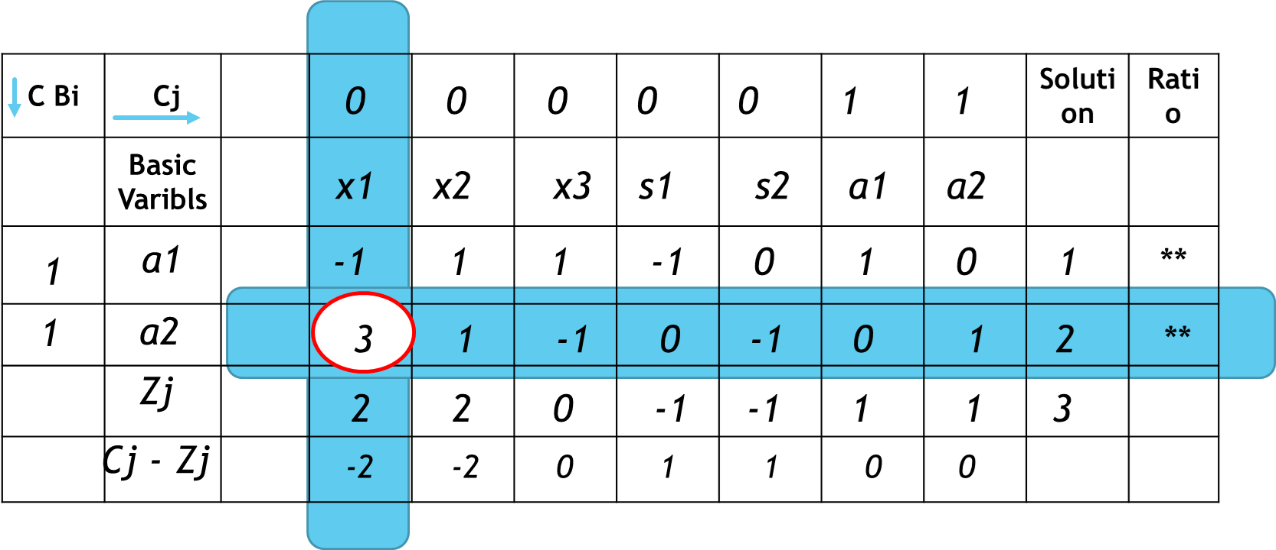
First Iteration Table
Optimality Condition For Minimization
All Cj – Zj >= 0
 | C Bi | Cj |  |  |  |  |  |  |  | Solution | Ratio
 |  | Basic Varibls
Row3
Row4
0 0 0 0 0 1 **
x1 x2 x3 s1 s2 a1 **
0
x1
1 1/3 -1/3 0 -1/3 0 ** 2/3
1
a1
0 4/3 2/3 -1 -1/3 1 ** 5/3
Zj
0 4/3 2/3 -1 -1/3 1
Cj - Zj
0 -4/3 -2/3 1 1/3 0
New x1 = old values / Key Element
Row4 Value
New a1 = Old Value –
Corresponding Key Col Val X Corresponding Key Row Value
Key Element Value

Slide 32
Iteration 1 Table
Entering Variable
 | C Bi | Cj |  |  |  |  |  |  |  | Solution | Ratio
 |  | Basic Varibls
Row3
Row4
0 0 0 0 0 1 **
x1 x2 x3 s1 s2 a1 **
0
x1
**
1 1/3 -1/3 0 -1/3 0 ** 2/3
1
a1
0 4/3 2/3 -1 -1/3 1 ** 5/3
**
Zj
0 4/3 2/3 -1 -1/3 1
Most Positive
Cj - Zj
0 -4/3 -2/3 1 1/3 0
Leaving Variable
Most Negative

Slide 33
Iteration 2 Table
 | C Bi | Cj |  |  |  |  |  |  |  | Solution | Ratio
 |  | Basic Varibls
Row5
Row6
0 0 0 0 0 ** **
x1 x2 x3 s1 s2 ** **
0
x2
**
0 1 1/2 -3/4 -1/4 ** ** 5/4
0
x1
1 0 -1/2 1/4 -1/4 ** ** 1/4
**
Zj
0 0 0 0 0
Cj - Zj
0 0 0 0 0
Optimality Condition
For Minimization
All Cj – Zj >= 0
Phase 1
Follow Simplex Method with REVISED Objective Function
End of Phase 1, check Objective Function Value is ZERO in Optimal Table
If yes, Go to Phase 2
Else, Conclude, The Problem does not have a Optimal Solution

Slide 34
Phase 2
Continue with Optimal Table for Phase 1 and REPLACE the objective Function with Original One

Slide 35
Phase 2
Minimize Z = 10 x1 + 6 x2 + 2 x3 + 0 s1 + 0 s2 + a1 + a2
 | C Bi | Cj |  |  |  |  |  |  |  | Solution | Ratio
 |  | Basic Varibls
10 6 2 0 0 ** **
x1 x2 x3 s1 s2 ** **
6
x2
**
0 1 1/2 -3/4 -1/4 ** ** 5/4
10
x1
1 0 -1/2 1/4 -1/4 ** ** 1/4
**
Zj
10 6 -2 -2 -4 10
Cj - Zj
0 0 4 2 4
Optimality Condition
For Minimization
All Cj – Zj >= 0
x1 = 1/4
x2 = 5/4
x3 = 0
Z = 10

Slide 36
Additional Example for Simplex Method

Slide 37
Example
Maximize Z = 2 x1 - x2 + 2 x3
Subject to Constraints
2 x1 + x2 <= 10
x1 + 2 x2 – 2 x3 <= 20
x1 + 2 x3 <= 5
x1, x2, x3 >= 0

Slide 38
Step – Convert all inequality constraints into equality (use slack variables)
Let’s add Slack Variables to Constraints & Objective Function
2 x1 + x2 +S1 = 10
x1 + 2 x2 – 2 x3 + S2 = 20
x1 + 2 x3 + S3 = 5
x1, x2, x3, S1, S2, S3 >= 0
We need to Add these Slack variables to the Objective Function too
Maximize Z = 2 x1 - x2 + 2 x3+ 0 s1 + 0 s2 + 0 s3

Slide 39
Step – Develop Initial Simplex Table 1
Maximize Z = 2 x1 - x2 + 2 x3+ 0 s1 + 0 s2 + 0 s3
C Bi | Cj | 2 | -1 | 2 | 0 | 0 | 0 | Soln | Ratio
 | Basic Variables | x1 | x2 | x3 | S1 | S2 | S3
0 | S1 | 2 | 1 | 0 | 1 | 0 | 0 | 10
0 | S2 | 1 | 2 | -2 | 0 | 1 | 0 | 20
0 | S3 | 1 | 0 | 2 | 0 | 0 | 1 | 5
 | Zj | 0 | 0 | 0 | 0 | 0 | 0
 | Cj-Zj | 2 | -1 | 2 | 0 | 0 | 0
Most Positive
2 x1 + x2 +S1 = 10
x1 + 2 x2 – 2 x3 + S2 = 20
x1 + 2 x3 + S3 = 5
For Maximization, Cj – Zj <=0

Slide 40
Step – Reach Optimality
Select the Maximum Value of Cj – Zj
The column of Maximum Cj – Zj value becomes the Key Column
Find the Ratio = Solution / Key Column
The Row with Minimum Value of Ratio is called Key Row
The intersection Point is called Key Element

Slide 41
Step – Develop Initial Simplex Table 1
Maximize Z = 2 x1 - x2 + 2 x3+ 0 s1 + 0 s2 + 0 s3
C Bi | Cj | 2 | -1 | 2 | 0 | 0 | 0 | Soln | Ratio
 | Basic Variables | x1 | x2 | x3 | S1 | S2 | S3
0 | S1 | 2 | 1 | 0 | 1 | 0 | 0 | 10 | 5
0 | S2 | 1 | 2 | -2 | 0 | 1 | 0 | 20 | 20
0 | S3 | 1 | 0 | 2 | 0 | 0 | 1 | 5 | 5
 | Zj | 0 | 0 | 0 | 0 | 0 | 0
 | Cj-Zj | 2 | -1 | 2 | 0 | 0 | 0
Least Positive
Most Positive
2 x1 + x2 +S1 = 10
x1 + 2 x2 – 2 x3 + S2 = 20
x1 + 2 x3 + S3 = 5
For Maximization, Cj – Zj <=0

Slide 42
Iteration 2
C Bi | Cj | 2 | -1 | 2 | 0 | 0 | 0 | Soln | Ratio
 | Basic Variables | x1 | x2 | x3 | S1 | S2 | S3
0 | S1 | 2 | 1 | 0 | 1 | 0 | 0 | 10 | 5
0 | S2 | 1 | 2 | -2 | 0 | 1 | 0 | 20 | 20
0 | S3 | 1 | 0 | 2 | 0 | 0 | 1 | 5 | 5
 | Zj | 0 | 0 | 0 | 0 | 0 | 0
 | Cj-Zj | 2 | -1 | 2 | 0 | 0 | 0
2 | x1 | 1 | ½ | 0 | ½ | 0 | 0 | 5 | Infy
0 | S2 | 0 | 3/2 | -2 | -1/2 | 1 | 0 | 15 | 15/2
0 | S3 | 0 | -1/2 | 2 | -1/2 | 0 | 1 | 0 | 0
 | Zj | 2 | 1 | 0 | 1 | 0 | 0
 | Cj-Zj | 0 | -2 | 2 | -1 | 0 | 0
New s2 = 2 – 1 * 1/2
Iteration 1
New x1 = old values / Key Element
New s2 = Old Value – Corresponding Key Col Value * New x1 Value
Iteration 2

Slide 43
Iteration 2
C Bi | Cj | 2 | -1 | 2 | 0 | 0 | 0 | Soln | Ratio
 | Basic Variables | x1 | x2 | x3 | S1 | S2 | S3
2 | x1 | 1 | ½ | 0 | ½ | 0 | 0 | 5
0 | S2 | 0 | 1 | 0 | -1 | 1 | -1 | 15
2 | x3 | 0 | -1/4 | 1 | -1/4 | 0 | ½ | 0
 | Zj | 2 | ½ | 2 | ½ | 0 | 1 | 10
 | Cj-Zj | 0 | -3/2 | 0 | -1/2 | 0 | -1
Iteration 3
For Maximization, Cj – Zj <=0
Final Solution
x1 = 2
x3 = 2
Z = 10

